Slide 1
YEN THE PRIMARY SCHOOL
GRADE 5

Slide 2
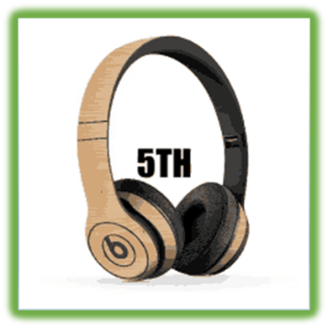
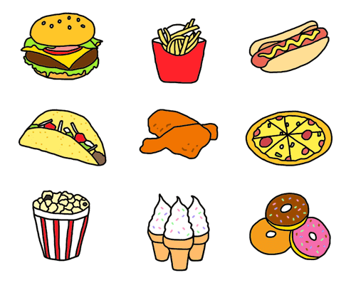
UNIT 3
The food here is great
Lesson 1

Slide 4
WATCH THE VIDEO CLIP

Slide 6
LISTEN AND POINT

Slide 7
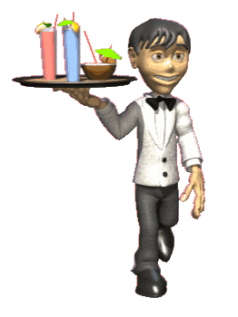
server

Slide 8
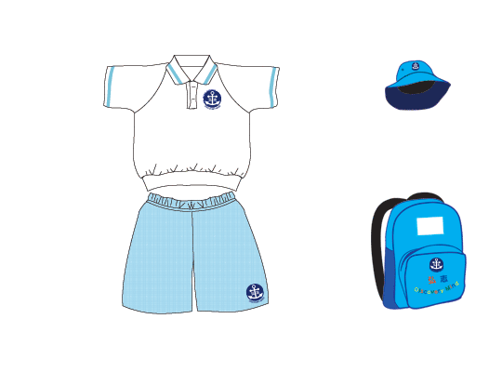
uniform

Slide 9
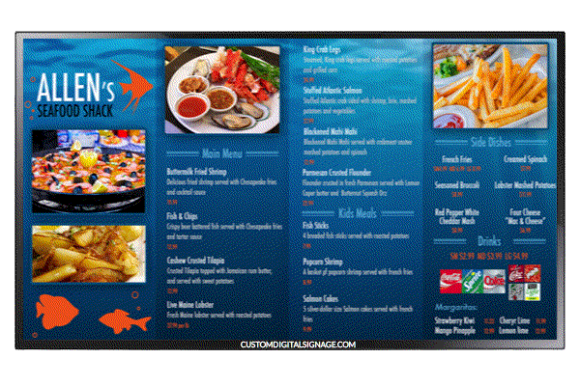
menu

Slide 10
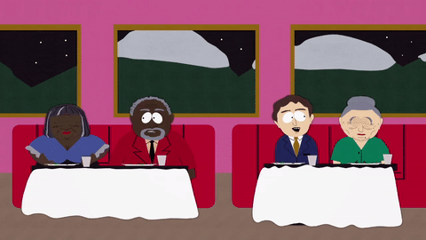
customer

Slide 11
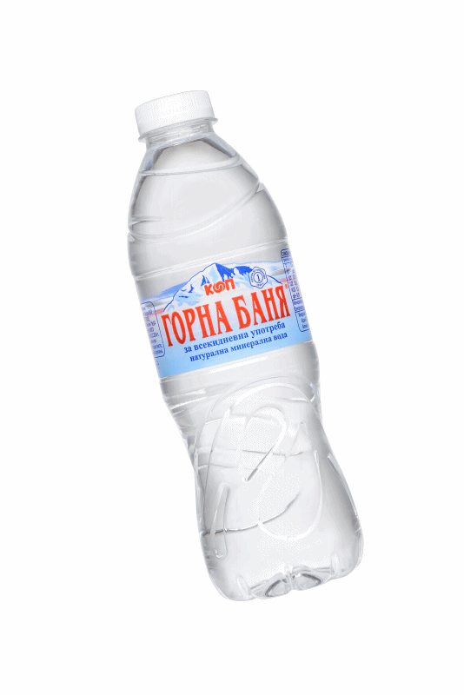
bottle of water

Slide 12
cup of coffee

Slide 13
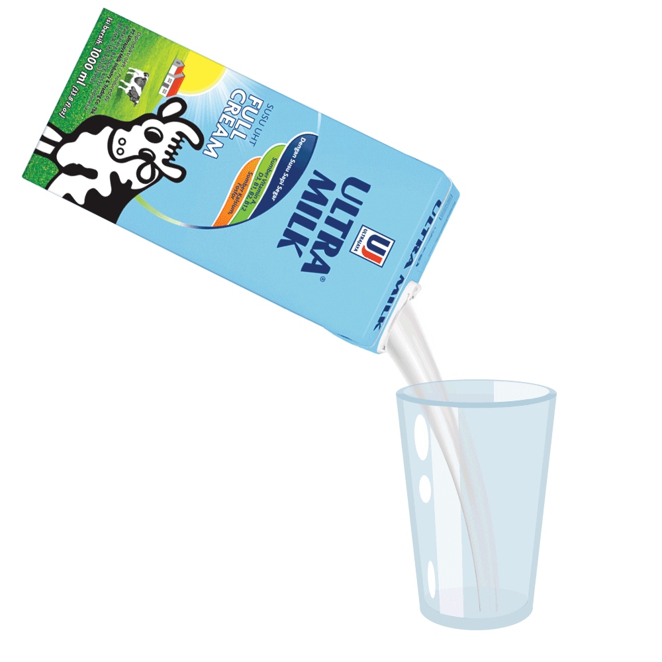
glass of milk

Slide 14
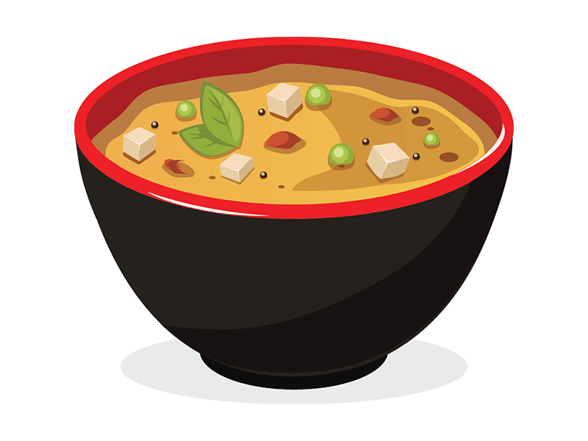
bowl of soup

Slide 15
LISTEN AND REPEAT

Slide 16
server

Slide 17
uniform

Slide 18
menu

Slide 19
customer

Slide 20
bottle of water

Slide 21
cup of coffee

Slide 22
glass of milk

Slide 23
bowl of soup

Slide 24
WORK IN PAIRS

Slide 25
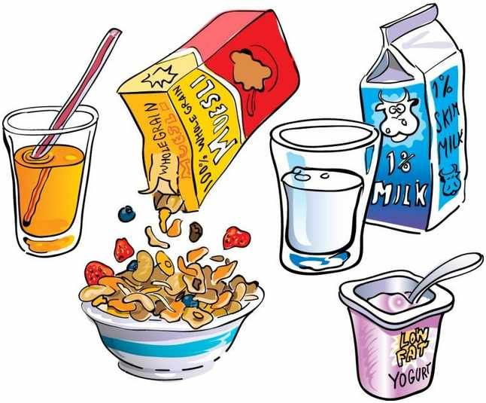
HIDDEN PICTURES
START

Slide 33
WATCH THE VIDEO CLIP
ANSWER THESE QUESTIONS:
Where are they?
What are they doing?
How many people are there?

Slide 35
GROUPWORK

Slide 36
Lesson 2

Slide 39
WORK IN PAIRS

Slide 40
Read, circle, and say.
1. She drink / is drinking / drinks a glass of water now.
2. The family sit / is sitting / sits by the door today.
3. They usually sit/ are sitting / sits by the window.
4. He never have / is having / has soup for dinner.
5. She have / is having / has soup today.

Slide 41
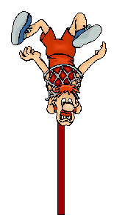
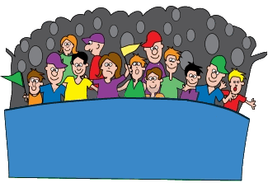
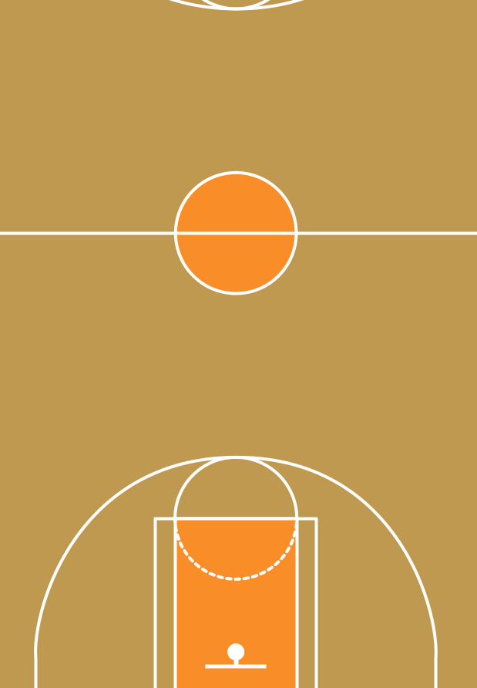
SIPMLE PRESENT vs PRESENT CONTINUOUS

Slide 42
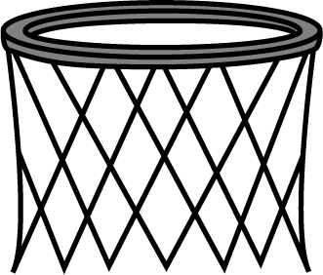
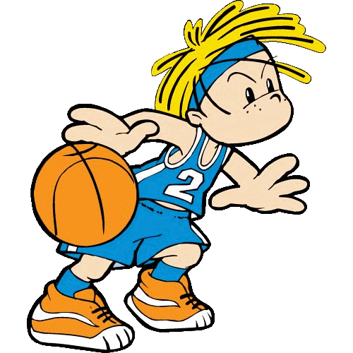
He ... a big bottle of milk every day.
drinks
is drinking

Slide 43
The family ... by the window today.
sits
is sitting

Slide 44
She never ... Pho for dinner.
has
is having

Slide 45
I ... to school now.
walk
am walking

Slide 46
We usually ... soup for breakfast.
have
are having

Slide 47
Write: has, playing, having (x2), play, share, have.
At break time, I usually ¹play with my friends, Tam and Anh. Anh isn't at school today, so I'm ²______ with Tam.
We're ³______ fun today. At lunchtime, I always ⁴_____ some rice and an apple. But there aren't any apples, so today I'm ⁵______ a banana. Anh usually ⁶____ salad and cookies. Sometimes she ⁷_____ her cookies with us. She's a kind girl.
playing
having
have
having
has
shares

Slide 48
WORKBOOK TIME

Slide 49
Lesson 3

Slide 50
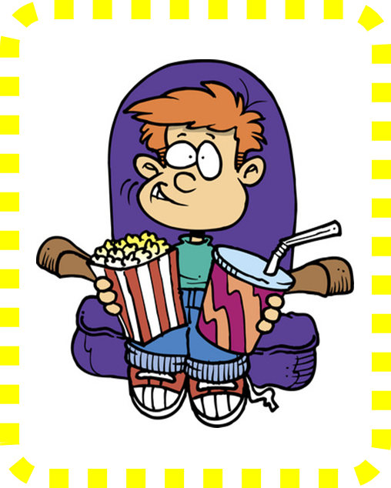
is watching
David ________ a film
at the cinema right now.
is watching
watches
watch

Slide 51
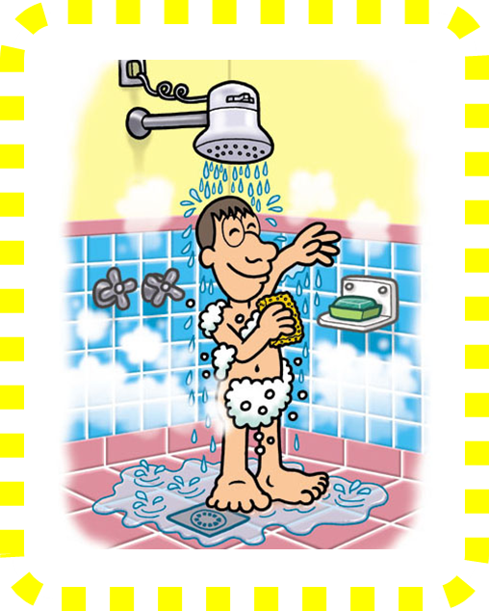
take
I ________ a shower
twice a day.
am takeing
take
am taking

Slide 52
are reading
The kids ________ books
at the moment.
is reading
are reading
read

Slide 53
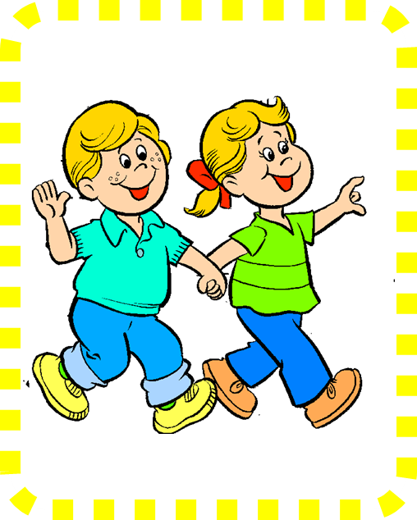
are going
Ben and I________
for a walk today.
are going
go
am going

Slide 54
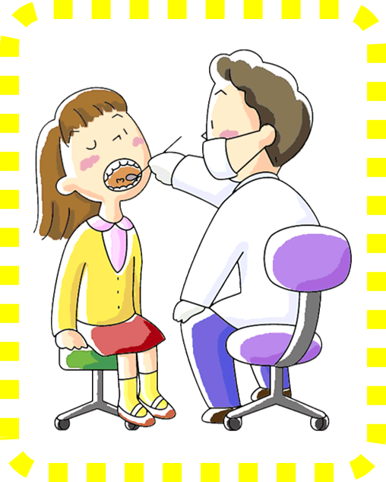
visits
Susan sometimes________ her dentist .
visit
is visiting
visits

Slide 55
reads
My dad always _______ a newspaper in the morning.
readds
reads
is reading

Slide 56
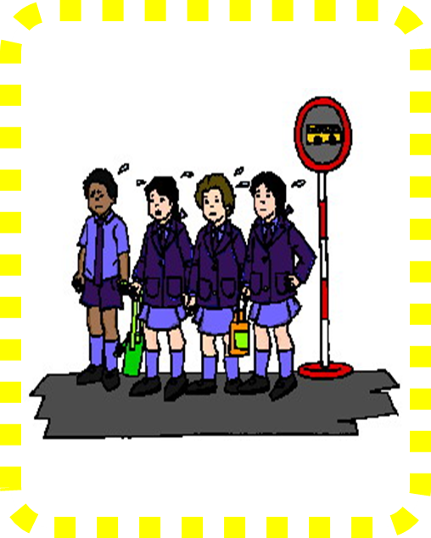
are waiting
They ________ at the bus stop right now.
is waiting
are waiting
wait

Slide 57
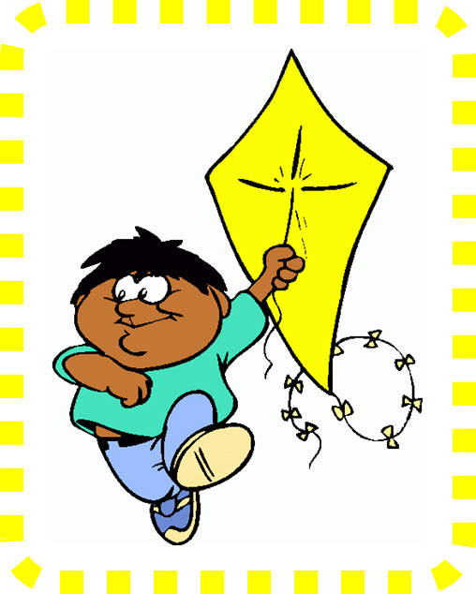
fly
I usually ________ my kite in the summer.
fly
am flying
flies

Slide 58
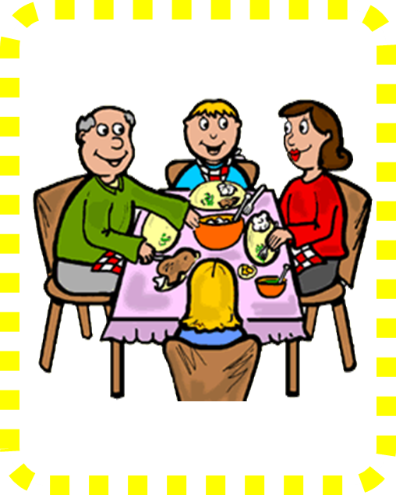
have
My family always _____ dinner togerther on Sundays.
is having
haves
have

Slide 59
LISTEN AND REPEAT

Slide 61
Choose a girl. Say and answer.
Example:
+ She usually has a bowl of salad. She's having some rice right now.
=> It's An.

Slide 62
Now write sentences about the girls.
An usually has a bowl of salad. An is having some rice right now.

Slide 63
LISTEN AND SING

Slide 65
WORKBOOK TIME

